Slide 1
Hygge
A website for chilling

Slide 2

Elevator Pitch
What?
How?
Why?

Slide 3

System and Functional Requirements
Simple, fun space for students
“No freaking out about University” zone
Project Vision: A website for students to chill
Project Rationale: Due to the increase in suicide scenarios, we were passionate about mental health.
Envisioned Stakeholders: Any and all Universities wanting to invest in their students

Slide 4

Limitations & Assumptions
Limitations:
Limited website experience
Time
Assumptions
No copyright infringement
Free Use

Slide 5

Team work/Responsibilities
•Jaskirat: Delegation of tasks, Script, Presentation
•Onisokien: The Middle Man (Helped with coding and creative side)
•Shrey: Coding Head

Slide 6
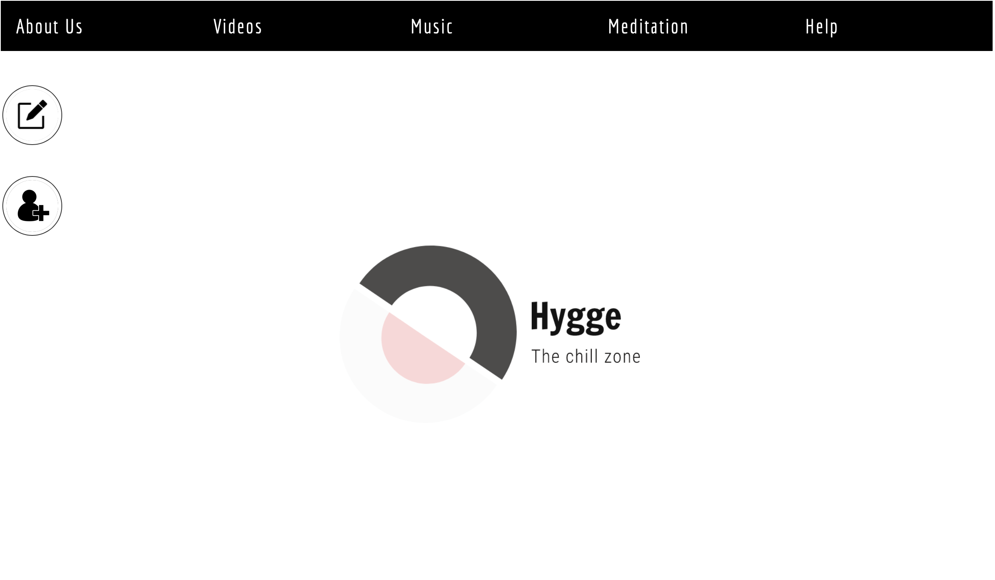
MVP 2 Demo
•Demo Website
•Good MVP
•Clean, Simple Website
•Changes
•More interactive
http://www2.cs.uregina.ca/~ayonoado/374/main.html

Slide 7

Feelings, Future MVPs & GitHub
Success!
•Accomplished everything we set out to do
Better-ifs
•More interactive
•No direction shifts did your team take?
•Code is clean
•Discuss what your team envisioned for potential next MVPs
•Take over Team Hygge

Slide 8
Group Reflection
•How did you feel about this project? What did you like about it? What did you dislike?
•What did you learn about yourself as you collaborated and worked through this project?
•How will you use what you have learned going forward?
•What “stuff & things” related to this project would you want help with? – Could have been better?

Slide 9

FIN

